Slide 2
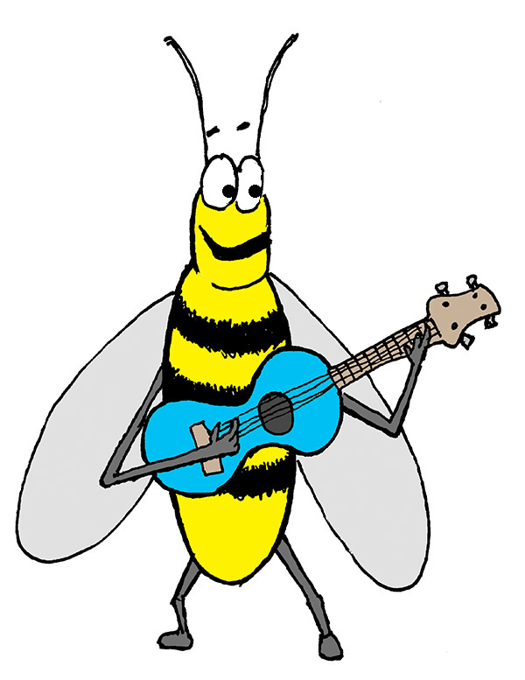
Hello, earth!
How do you do?
I’m so very glad
we live on you.
Yes, we do.

Slide 3
Ev’ry blade of
grass and tree,
sunny sky and
honey bee needs you.
Yes, they do.

Slide 4
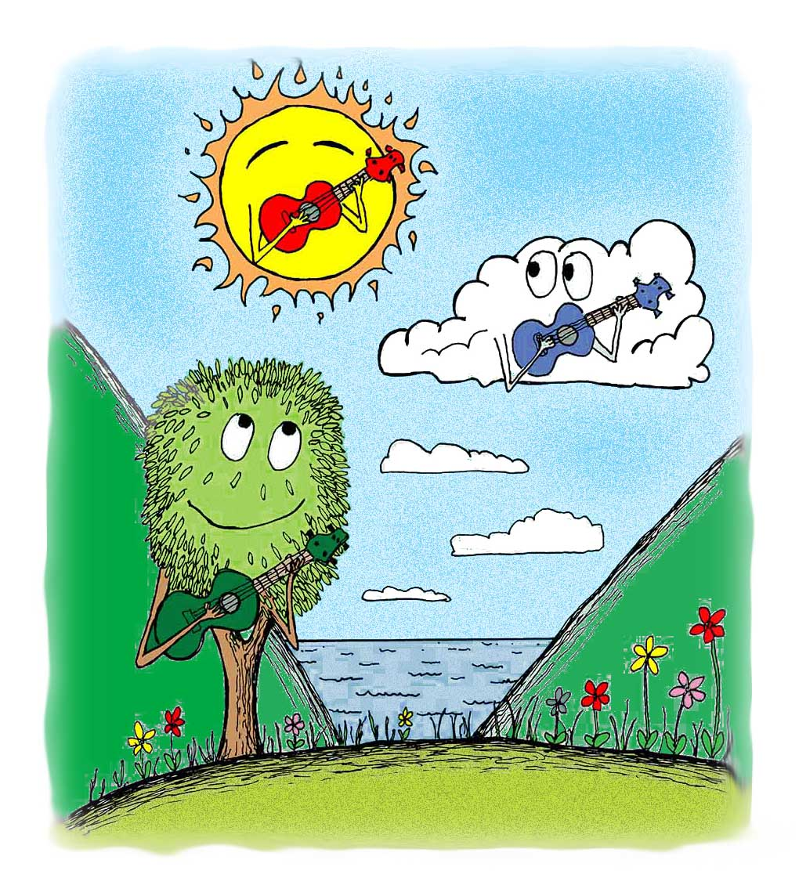
A forest or
a desert.
An ocean,
pond, or sea.

Slide 5
We all must
work together.
Earth depends
on you
and me.

Slide 6
Hello, earth!
How do you do?
I’m so very glad
we live on you.
Yes, we do.

Slide 7
A prairie,
hill, or valley.
The mountain
majesties.

Slide 8
We all must
work together.
Earth depends
on you
and me.

Slide 9
Hello, earth!
How do you do?
I’m so very glad
we live on you.
Yes, we do.

Slide 10
We need you.
Yes, we do.
We need you.
Yes, we do.

