Slide 2
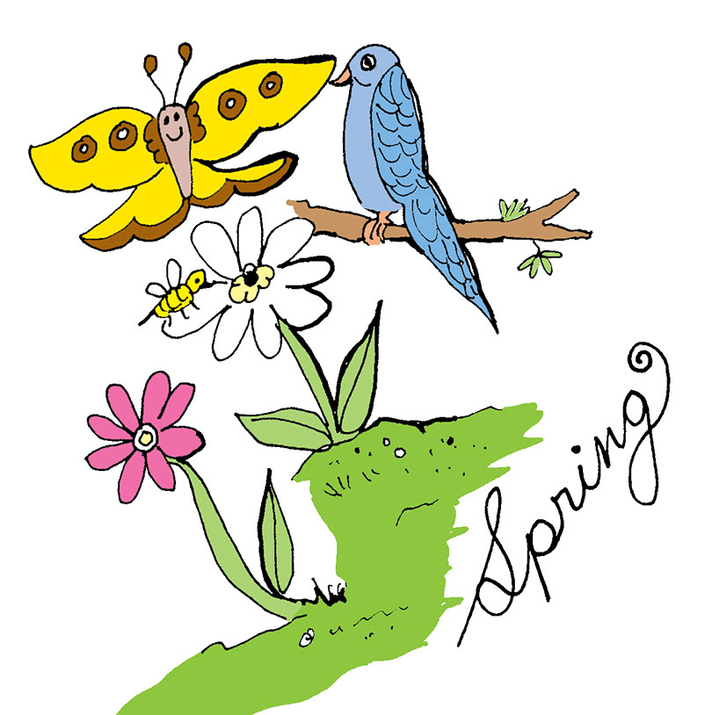
sing in unison 1st time:
Birds and bees and
ev’rything spring.
Butterflies and
ev’rything spring.

Slide 3
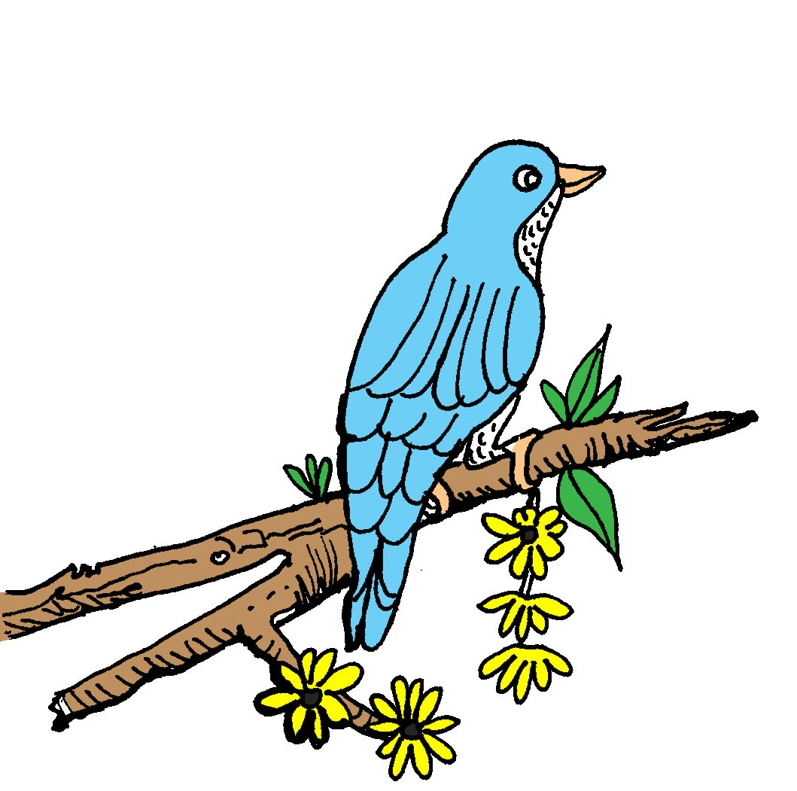
Buds and trees and
ev’rything spring.
You and me
and ev’rything, ev’rything

Slide 4
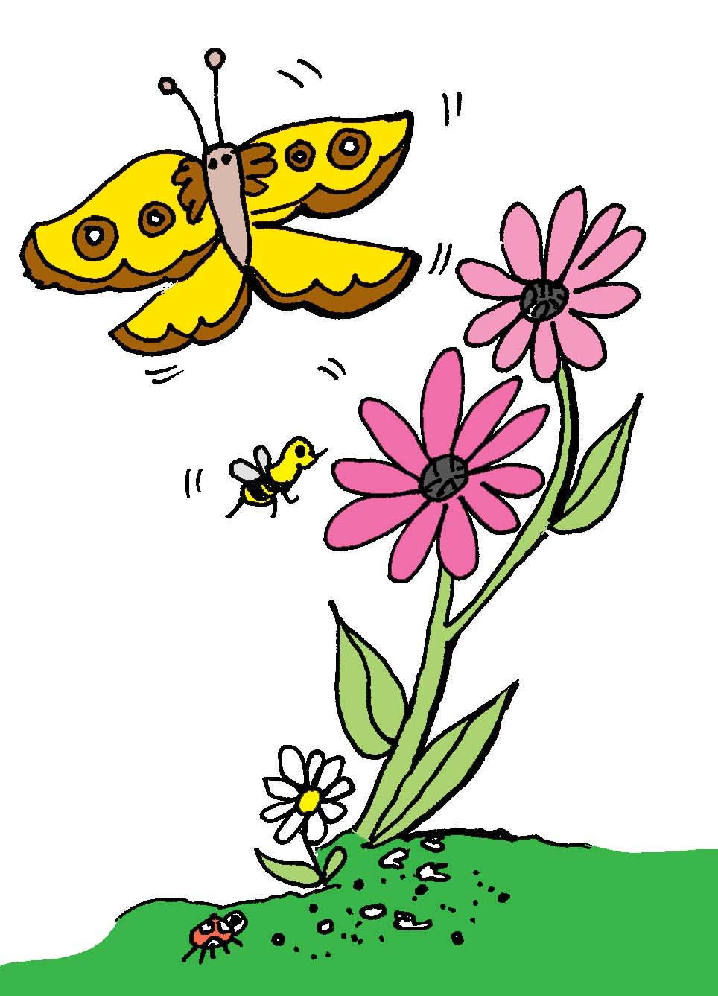
spring, spring,
ev’rything.
Spring, spring,
ev’rything spring.

Slide 5
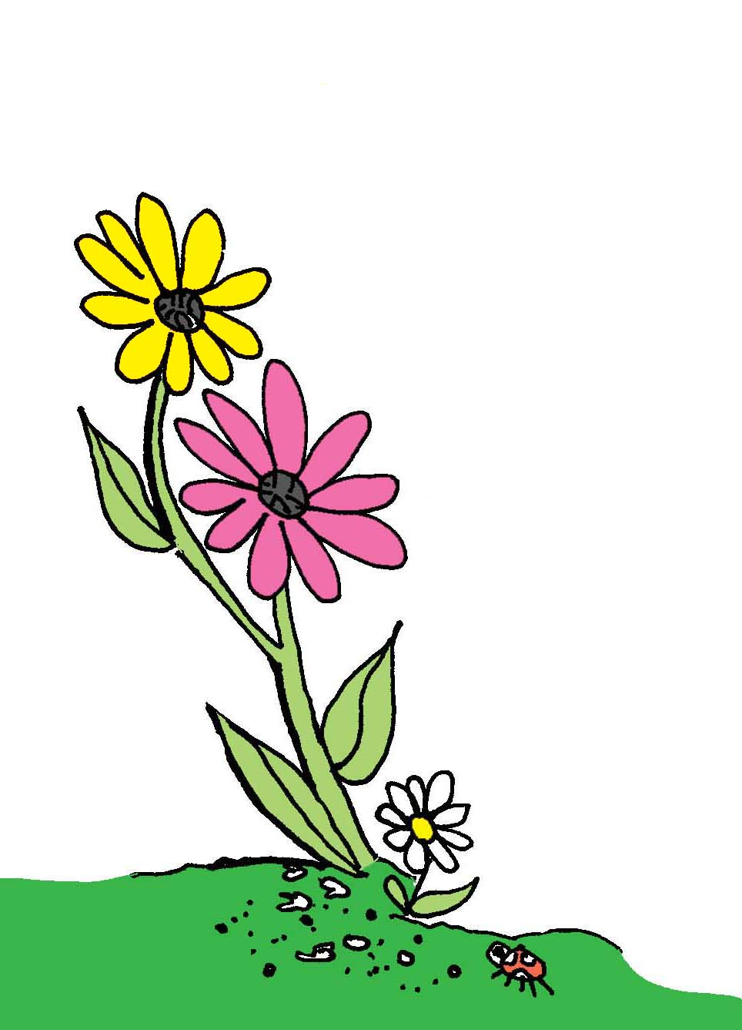
Spring, spring,
ev’rything.
Spring, spring,
ev’rything spring.
Spring.(ng)

Slide 6
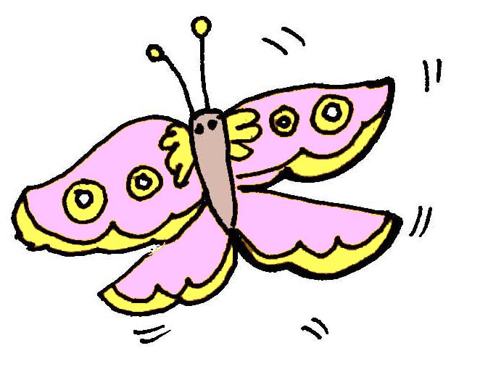
sing as round 2nd time:
Birds and bees
and ev’rything
spring.
sing as round 2nd time:
Birds and bees
and ev’rything
spring.

Slide 7
Butterflies and
ev’rything spring.
Butterflies and
ev’rything spring.

Slide 8
Buds and trees
and ev’rything
spring.
Buds and trees
and ev’rything
spring.

Slide 9
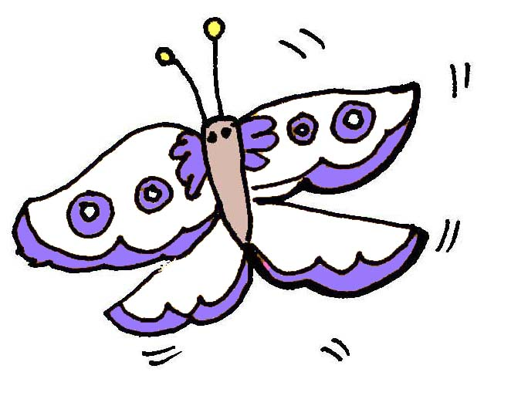
You and me
and ev’rything,
ev’rything
You and me
and ev’rything,
ev’rything

Slide 10
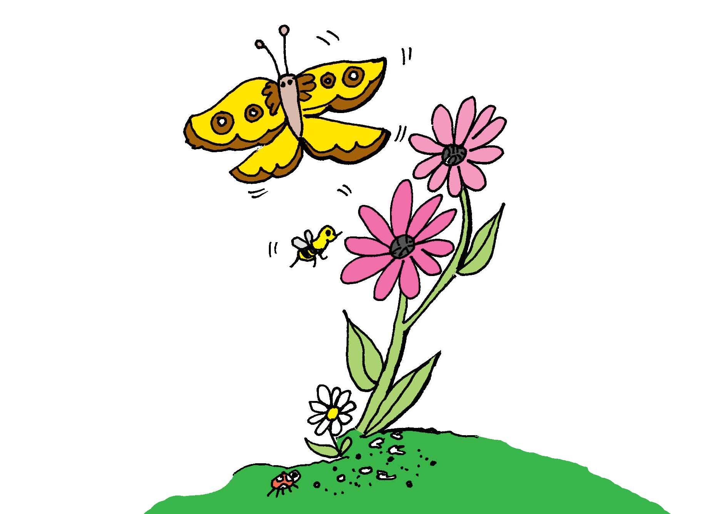
spring, spring,
ev’rything.
spring, spring,
ev’rything.

Slide 11
Spring, spring,
ev’rything
spring.
Spring, spring,
ev’rything
spring.

Slide 12
Spring, spring,
ev’rything.
Spring, spring,
ev’rything.

Slide 13
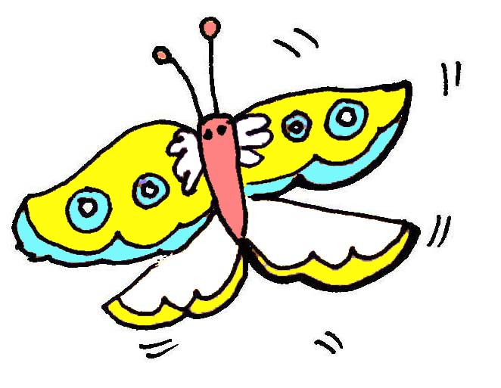
Spring, spring,
ev’rything
spring.
Spring.(ng)
Spring, spring,
ev’rything
spring.
Spring.(ng)

Slide 14
Spring,
spring.
Ev’rything
spring.(ng)
Spring.
Spring,
spring.
Ev’rything
spring.(ng)
Spring.

