Slide 2
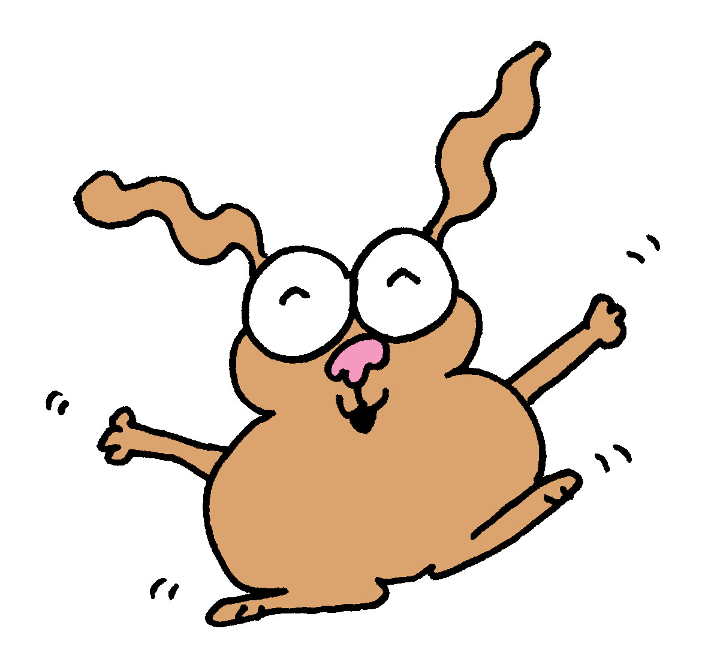
shout:
Get up on your feet!
Get up on your feet!
Get up on your feet!
Put your hands together!

Slide 3
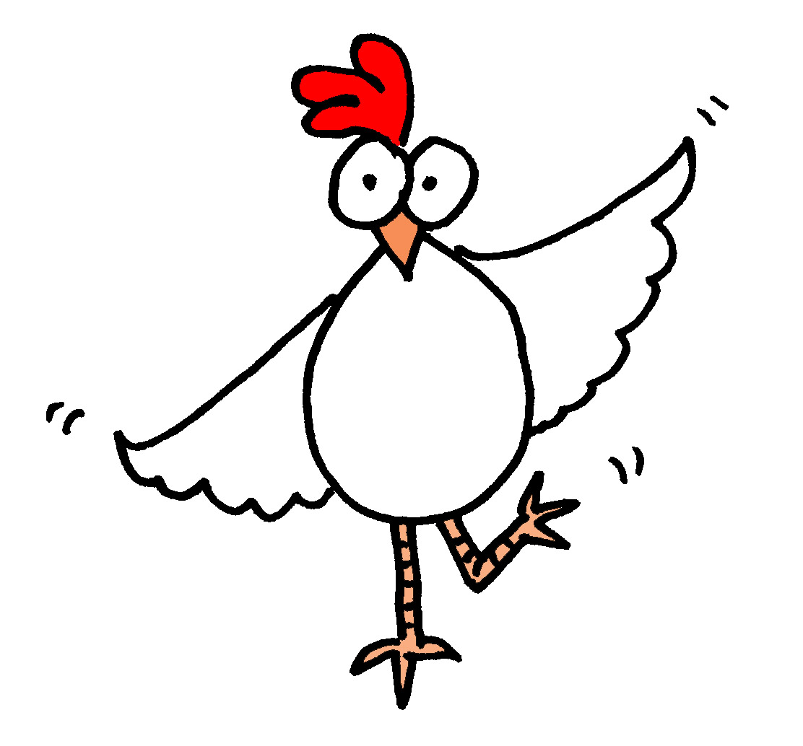
Get up on your feet!
Get up on your feet!
Get up on your feet!
Put your hands together!

Slide 4
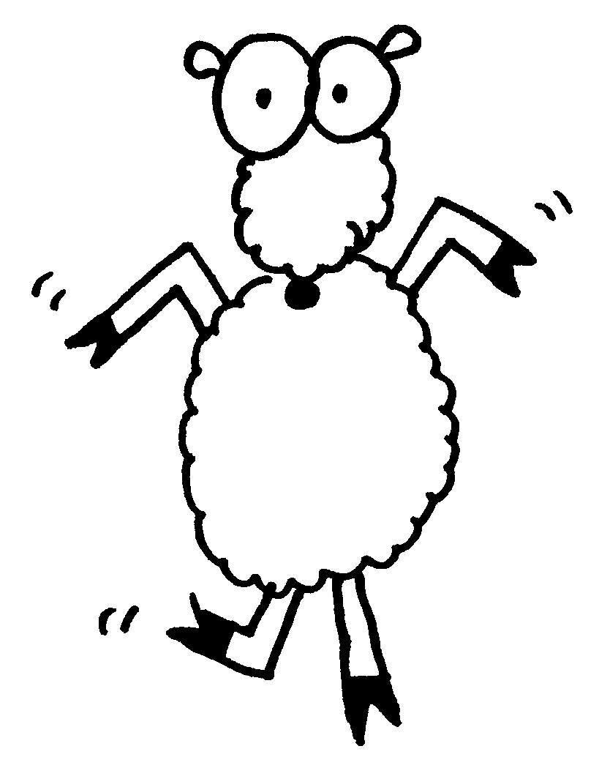
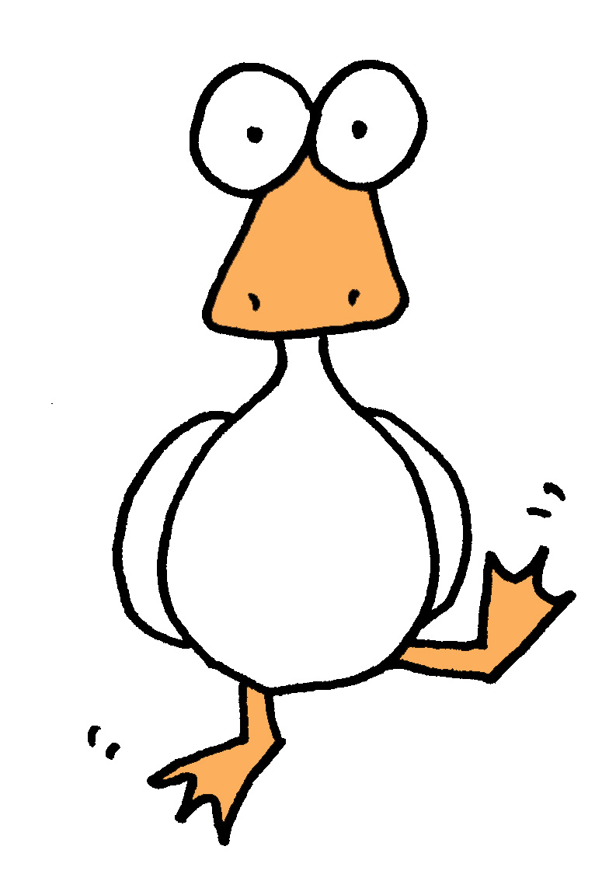
sing:
Feel the groove!
Time to move!
That’s the beat!
Move your feet!

Slide 5
shout:
Get up on your feet!
Get up on your feet!
Get up on your feet!
Put your hands together!

Slide 6
Get up on your feet!
Get up on your feet!
Get up on your feet!
Put your hands together!

Slide 7
sing:
Feel the groove!
Time to move!
That’s the beat!
Move your feet!

Slide 8
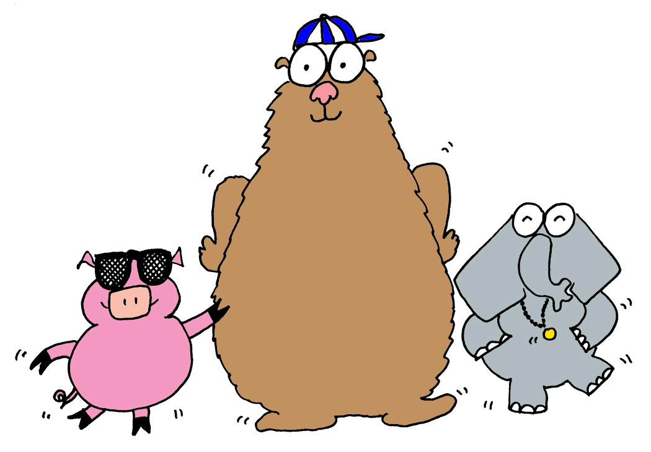
shout:
Get up on your feet!

