Slide 2
optional vocal introduction:
Oh, I know
it starts with me.
Yes, I know
it starts with me.
(segue after pause)

Slide 3
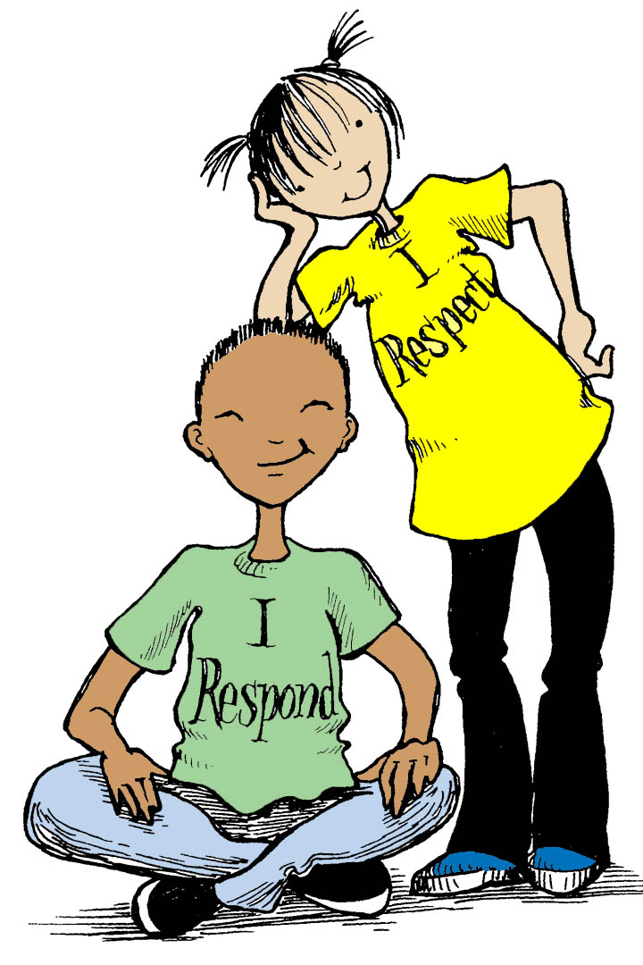
all:
We’re changing the world
one person at a time.
We’re making it better,
don’t you see?

Slide 4
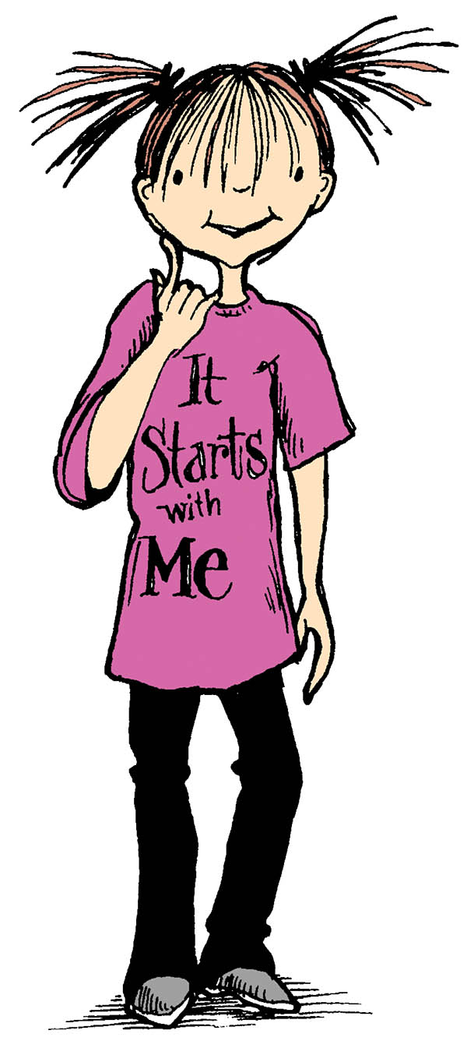
We’re changing the world
one person at a time.
The very first person
is me, is me.

Slide 5
part 1:
For I know
it starts
with me.
parts 2 & 3:
For I know
it starts
with me,
with me.

Slide 6
Yes, I know
it starts
with me.
It starts
with me.
Yes, I know
it starts
with me.

Slide 7
We’re changing
the world
one person
at a time.
part 2:
We’re changing
the world.
Changing it
one at a time.

Slide 8
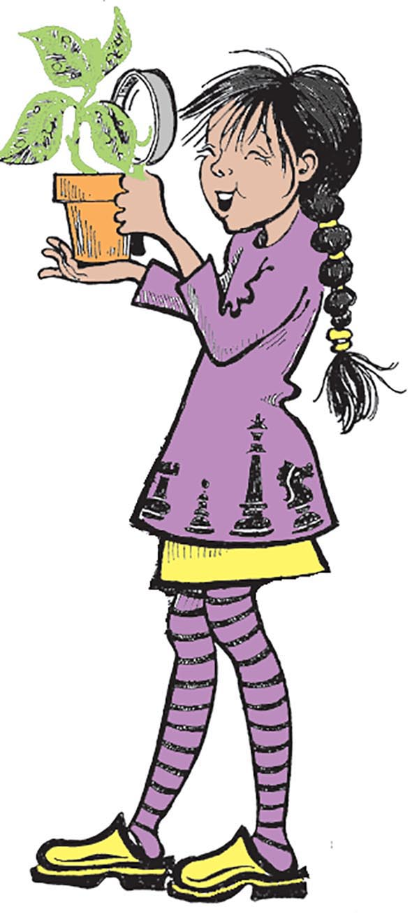
We’re making
it better,
don’t you see?
We’re making
it better,
don’t you see?
Don’t you see?

Slide 9
We’re changing
the world
one person
at a time.
We’re changing
the world.
Changing it
one at a time.

Slide 10
The very
first person
is me, is me.
The first person
is me, is me.

Slide 11
part 1:
For I know
it starts
with me.
parts 2 & 3:
For I know
it starts
with me,
with me.

Slide 12
Yes, I know
it starts
with me.
It starts
with me.
Yes, I know
it starts
with me.

Slide 13
The lessons
I learn
I will share
with you.
And if you share
them, too,

Slide 14
the world
will change.
The world
will change.
(The world
will change.)

Slide 15
The world
will grow.
The world
will grow.
(The world
will grow.)

Slide 16
And it’s all
because
I know!
It’s all
because
I know,
I know!
(I know,
I know!)

Slide 17
Oh, I know
it starts
with me.
Oh, I know
it starts
with me,
with me.

Slide 18
Yes, I know
it starts
with me.
Yes, I know
it starts
with me.

Slide 19
Oh, I know
it starts
with me.
Oh, I know
it starts
with me,
with me.

Slide 20
Yes, I know
it starts
with me.
Yes, I know
it starts
with me.

Slide 21
It starts
with me!
It starts
with me!
It starts
with me!
It starts
with me!

Slide 22
It starts
with me!
It starts
with me!
It starts
with me!
Me!

Slide 23
yell:
Me!
yell:
Me!

