Slide 2
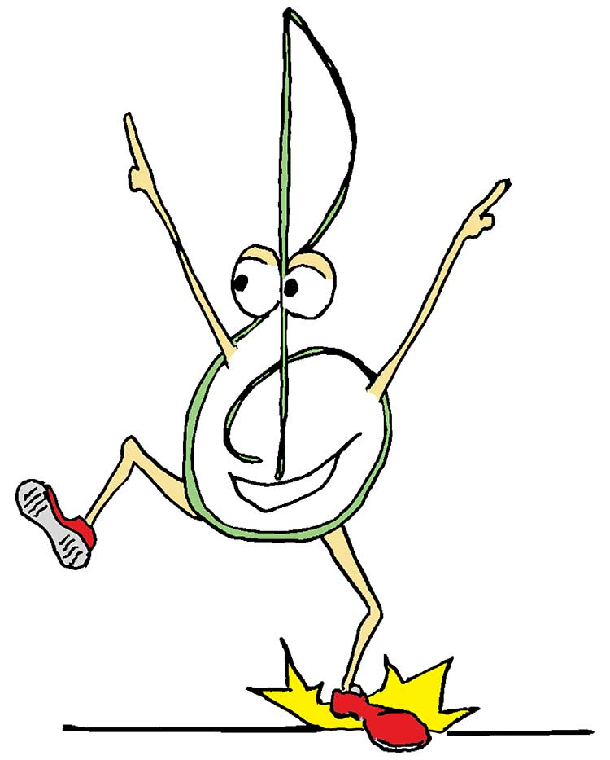
Welcome to music class.
Welcome to music class.

Slide 3
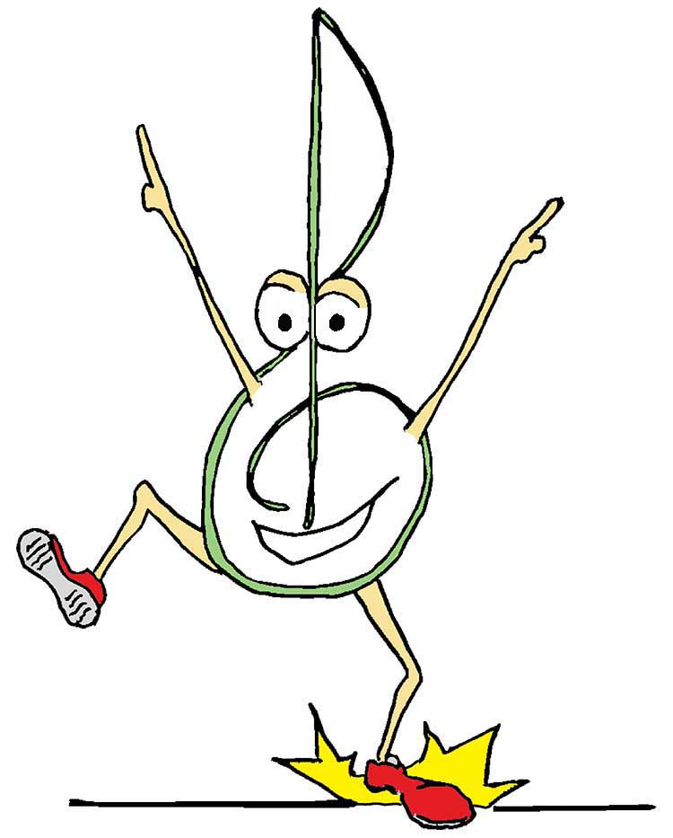
Where we learn
melodies and harmonies,
(divisi, optional): harmonies.

Slide 4
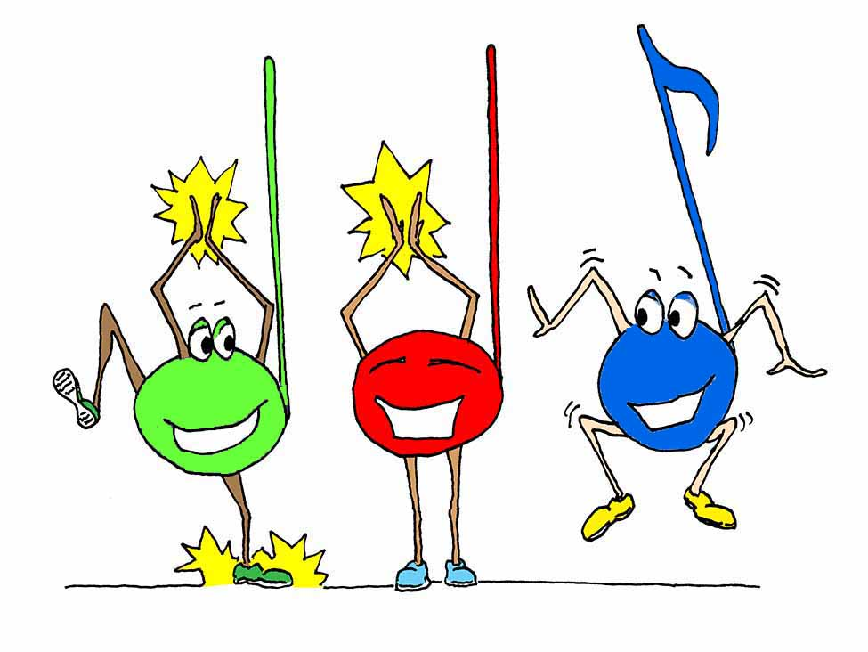
But rhythm.
Oh, rhythm.
It is our fav’rite!
Our fav’rite!
Rhythm.
Our fav’rite!

Slide 5
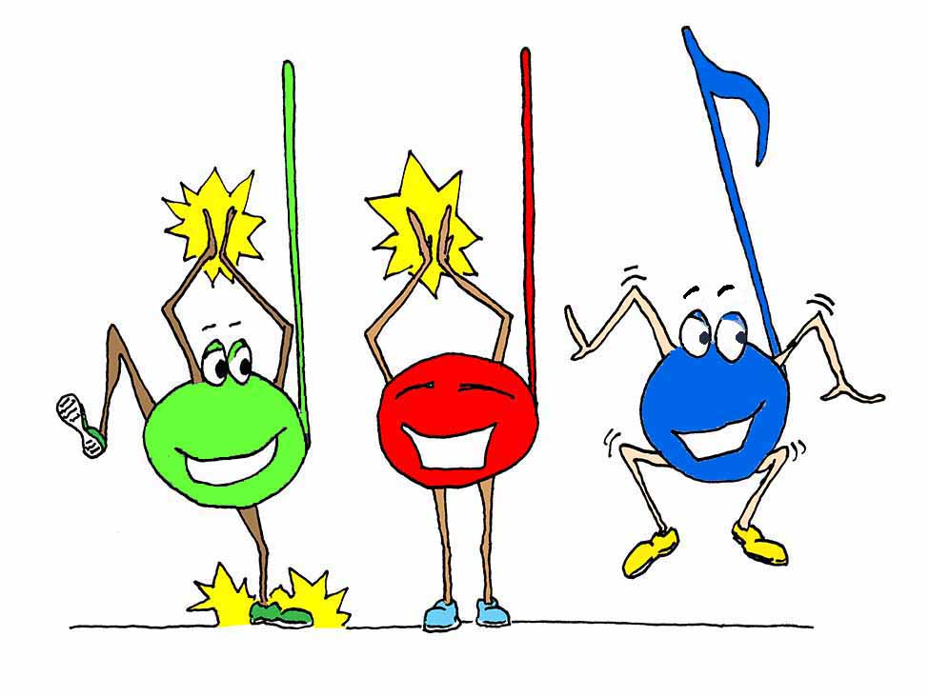
Rhythm.
Rhythm.

Slide 6
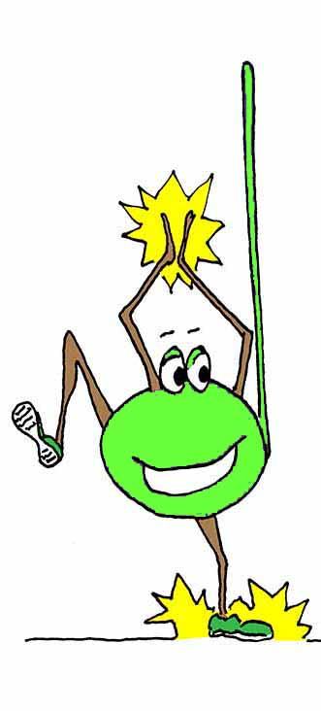
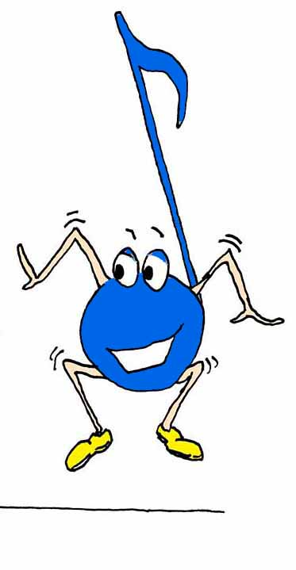
We’ve got rhythm.
Rhythm.

Slide 7
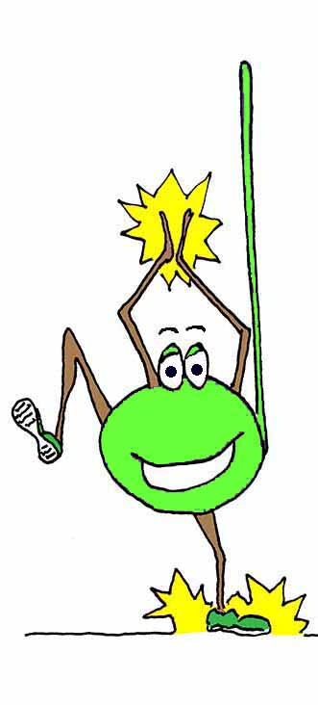
Rhythm.
Oh, rhythm.

Slide 8
Welcome to music class.
Welcome to music class.

Slide 9
Where we learn
melodies and harmonies,
(div., opt.): harmonies.

Slide 10
But rhythm. Oh, rhythm.
It is our fav’rite!

